Slide 1
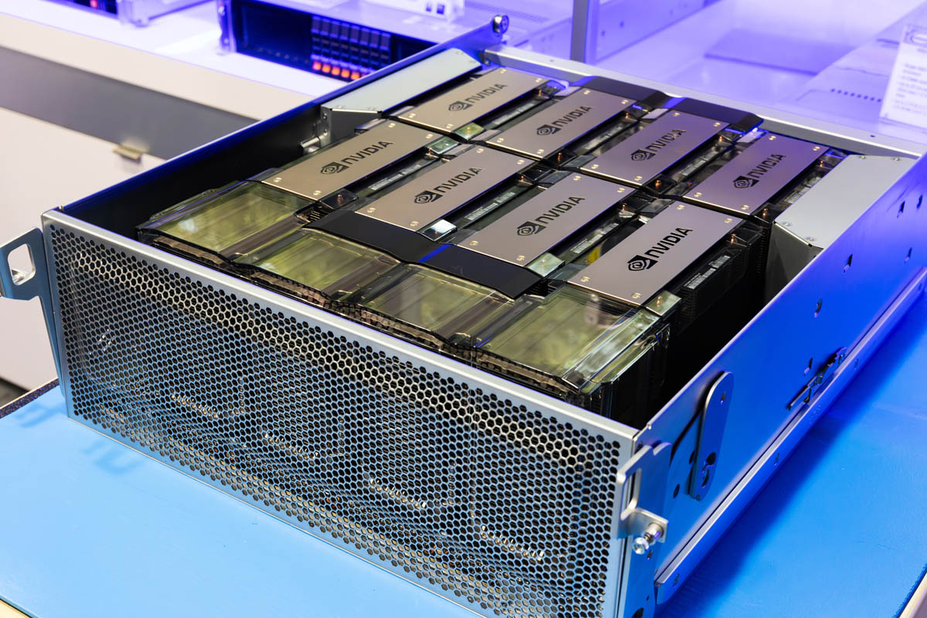
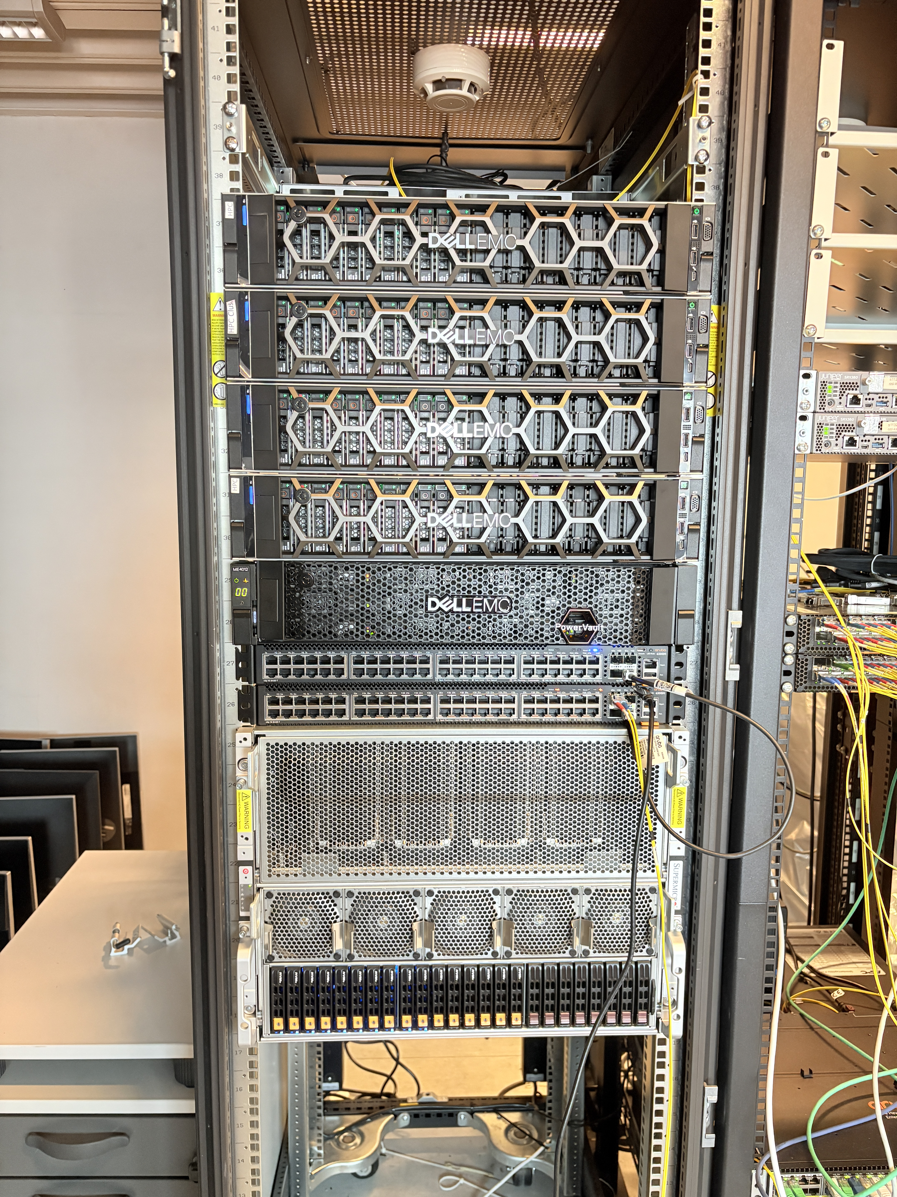
HPC with GPU power for Research and Education
GPU node
Presenter:
Guru Bhandari
Software-Engineer/Researcher/HPC-admin
Kristiania University of Applied Sciences
HPC
Location: Kirkegata 24

Slide 2

Session Outline
Introduction to HPC and GPU
Comparison of CPU and GPU
Applications of HPC
Advantages of using an HPC cluster
Example experiments
Tour of the HPC hardware setup (optional)

Slide 3
What is HPC?
High Performance Computing = Many computers working together to solve big problems.
Much faster than normal computers.
Why GPU?
A Graphics Processing Unit (GPU) consists of a large number of processing cores (H200 GPU - 16,896 CUDA cores), enabling it to perform numerous calculations in parallel.
Accelerates AI model training and inference
Fast processing of huge datasets (image, video, or text)
Grok 3 - 200,000 NVIDIA H100 GPUs

Slide 4
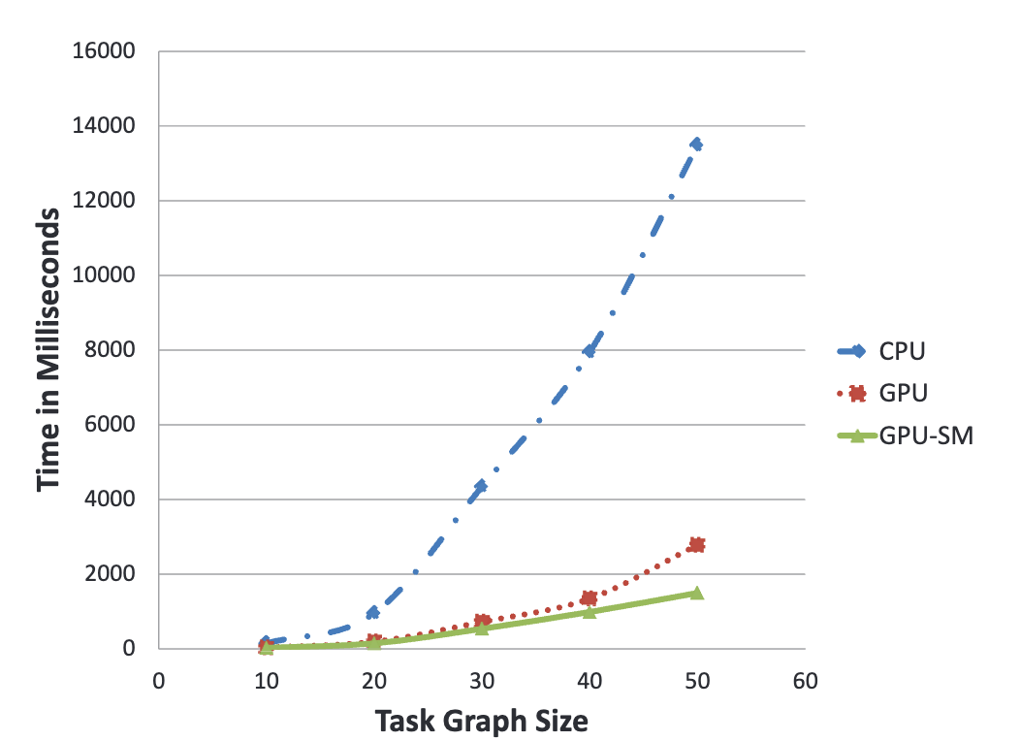
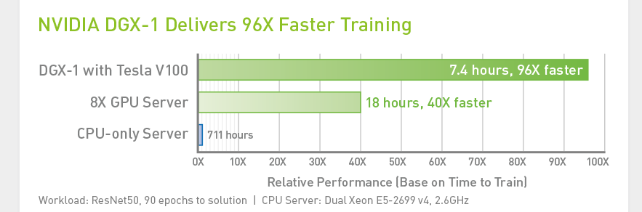
Comparison of CPU, GPU and GPU-SM (shared memory) execution times
Source: Nunna, S., Bordoloi, U. D., Chakraborty, S., Eles, P., & Peng, Z. (2010, December). Exploiting GPU on-chip shared memory for accelerating schedulability analysis. In 2010 International Symposium on Electronic System Design (pp. 147-152). IEEE.

Slide 5
Applications of HPC
Scalable AI & ML Use GPU-powered deep learning for vision, language, and multimodal research; train LLMs and deploy AI pipelines for real-world tasks.
Simulation & Modeling Run complex simulations for innovation systems, supply chains, and economic analyses with parallel processing.
Cybersecurity Research Simulate threats, security models, and evaluate system resilience at scale.
Education BA/MA students get hands-on experience on industry-grade equipment.

Slide 6
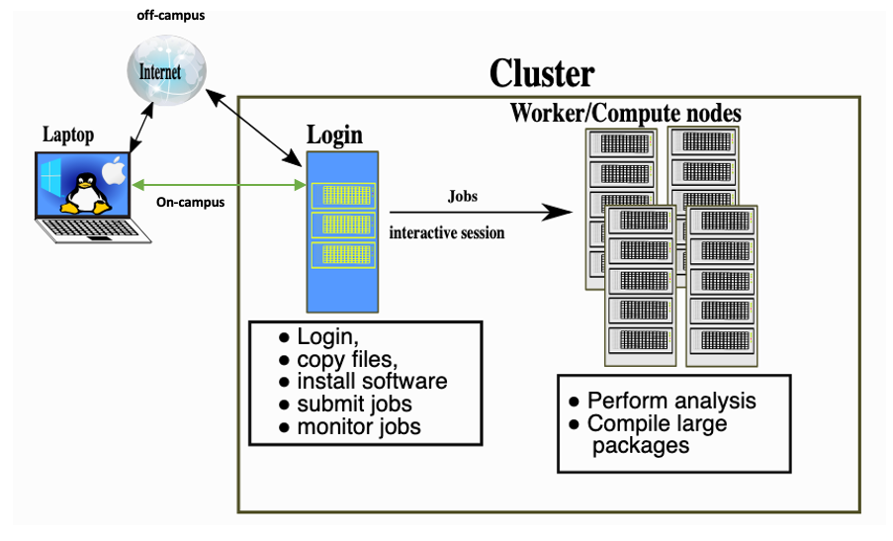
Workload management
Source: https://training.pages.sigma2.no/tutorials/hpc-intro/index.html

Slide 7
Mgmt PC
Switches
Login Node
CPUQ-01 (Compute1)
CPUQ-02 (Compute2)
CPUQ-03 (Compute3)
Shared Storage
HGXQ-01 (GPU node)
What we have in Kristiania-HPC cluster?
Login node hosts:
Slurm scheduler
Beegfs file system
Monitoring tools
Home dir (100GB)
Login space
Internet flow
Storage node has-
Software modules
Project storage (1TB)

Slide 8
HPC specification
GPU specification
Node Name | CPUs | Memory (GB) | Sockets | Cores/Socket | Threads/Core | GPUs | Partition
epyc1 | 64 | 251 GB | 1 | 32 | 2 | 0 | CPUQ
epyc2 | 64 | 251 GB | 1 | 32 | 2 | 0 | CPUQ
epyc3 | 64 | 251 GB | 1 | 32 | 2 | 0 | CPUQ
hgx | 384 | 3023 GB | 2 | 96 | 2 | 8 | HGXQ
Feature | HGX H200 8-GPU Configuration
GPU Architecture | NVIDIA Hopper
Number of GPUs | 8x H200 SXM
GPU Memory per GPU | 141 GB HBM3e
Total GPU Memory | 1,128 GB
GPU Memory Bandwidth | 4.8 TB/s per GPU
FP8 Tensor Core Performance | 32 PFLOPS (with sparsity)
NVLink Bandwidth per GPU | 900 GB/s
Note:
Epyc1, 2 and 3 have Dell PowerEdge R7515 AMD 7542 2.9PGz, 32C/64T128M, 225W, 3200 in each.
Persistent storage: Dell EMC ME4012 Storage Array 192TB hard drives
Dell EMC S4112 for networking

Slide 9
How to Use GPUs?
1. Programming Frameworks
CUDA (NVIDIA) → The most common low-level API for writing GPU-accelerated code.
OpenCL → Open standard supported by different vendors.
HIP (AMD ROCm) → Alternative to CUDA for AMD GPUs.
2. High-Level Libraries
Machine Learning: TensorFlow, PyTorch, JAX — all support GPU acceleration.
Data Processing: RAPIDS (GPU-accelerated data science), cuDF (Pandas-like GPU library).
Math/Simulation: cuBLAS, cuFFT, cuDNN, and other NVIDIA libraries.
3. HPC & Parallel Computing
MPI + CUDA for multi-node GPU clusters.
GPU support in simulation packages like GROMACS, LAMMPS, and OpenFOAM.
4. Practical Usage
On local machines: Install CUDA drivers, use PyTorch/TensorFlow with GPU backend, Metal Performance Shaders (MPS).
On HPC clusters: Request GPU nodes via job scheduler (e.g., SLURM with #SBATCH --gres=gpu:1).
On cloud platforms: Use GPU-enabled instances (AWS EC2 P3/P4, Google TPU/GPU, Azure NC series).

Slide 10
Benefits of using HPC:
Big data analysis
Sequential and parallel computationally expensive tasks
Collaborating in research projects
Storage and sharing of big data
Utilization of high bandwidth
Speed and scalability
Security
Cost efficiency

Slide 11
Who can use the Kristiania-HPC infrastructure?
Users: Graduate students, PhD students, researchers, and employees
Groups: Projects or Labs
Storage: Home dir - 100GB, and project dir – 1TB
Accessibility: user-level, project-level, and admins

Slide 12

Additional information on HPC
A separate email address for HPC- hpc@kristiania.no.
HPC site-
https://kristiania-hpc.github.io/
A short description and link of the HPC site to Kristiania’s research portal.
Additional resources:
Examples: https://https://github.com/kristiania-hpc/examples
Documentation: https://training.pages.sigma2.no/tutorials/hpc-intro/episodes/12-cluster.html
Training on HPC to the researchers/graduates: once in every six months (or twice).

Slide 13
How to use it?
SSH login
Example experiments
VScode integration

Slide 14
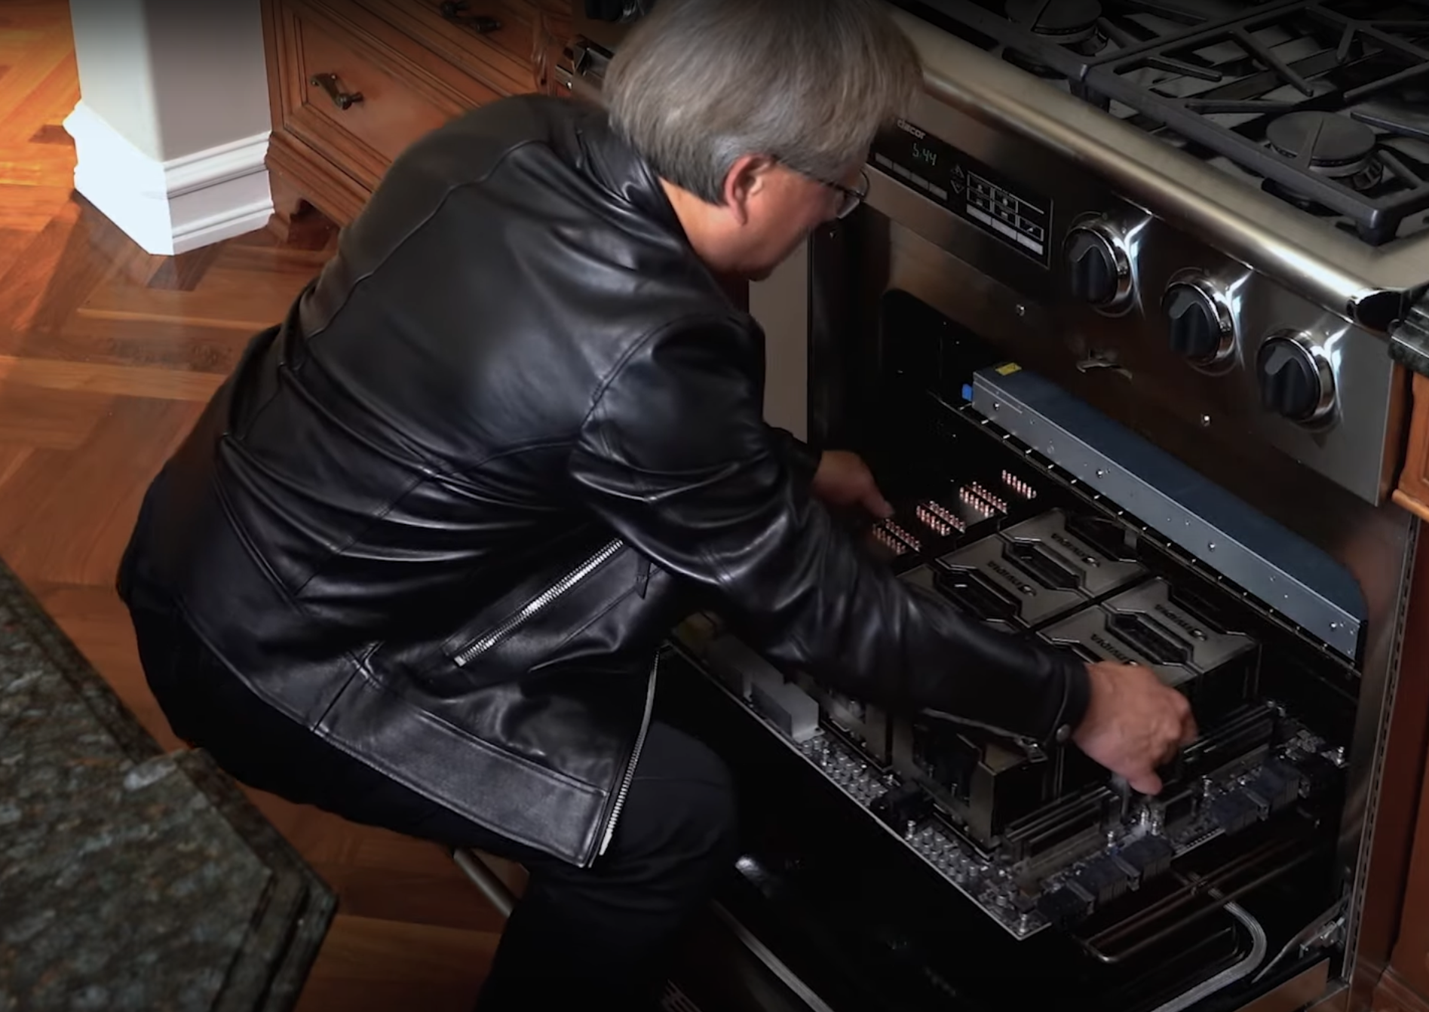
Questions ??

